Slide 1




Orbit Mate helps astronauts combat loneliness and maintain mental health during space missions.
Your reliable friend in space!

Slide 2




Orbit Mate also checks the astronaut’s physical health.
Orbit Mate helps astronauts combat loneliness and maintain mental health during space missions.

Slide 3
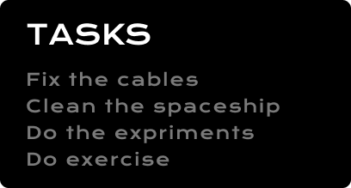
Reminds the astronaut of the tasks they have to complete.
Orbit Mate also checks the astronaut’s physical health.
Orbit Mate helps astronauts combat loneliness and maintain mental health during space missions.

Slide 4
Reminds the astronaut of the tasks they have to complete.
Orbit Mate also checks the astronaut’s physical health.
Orbit Mate helps astronauts combat loneliness and maintain mental health during space missions.

Slide 5



Reminds
tasks
Provides emotional balance
Supports physical health
But why?
Reminds the astronaut of the tasks they have to complete.

Slide 6
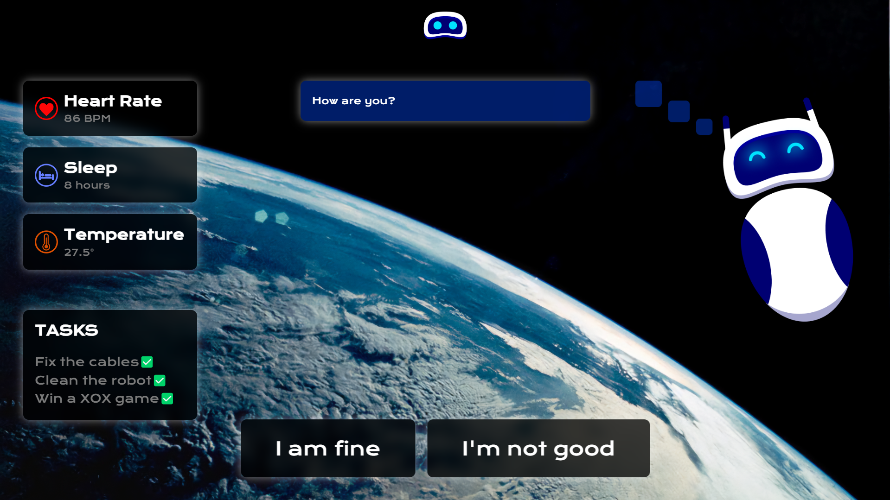
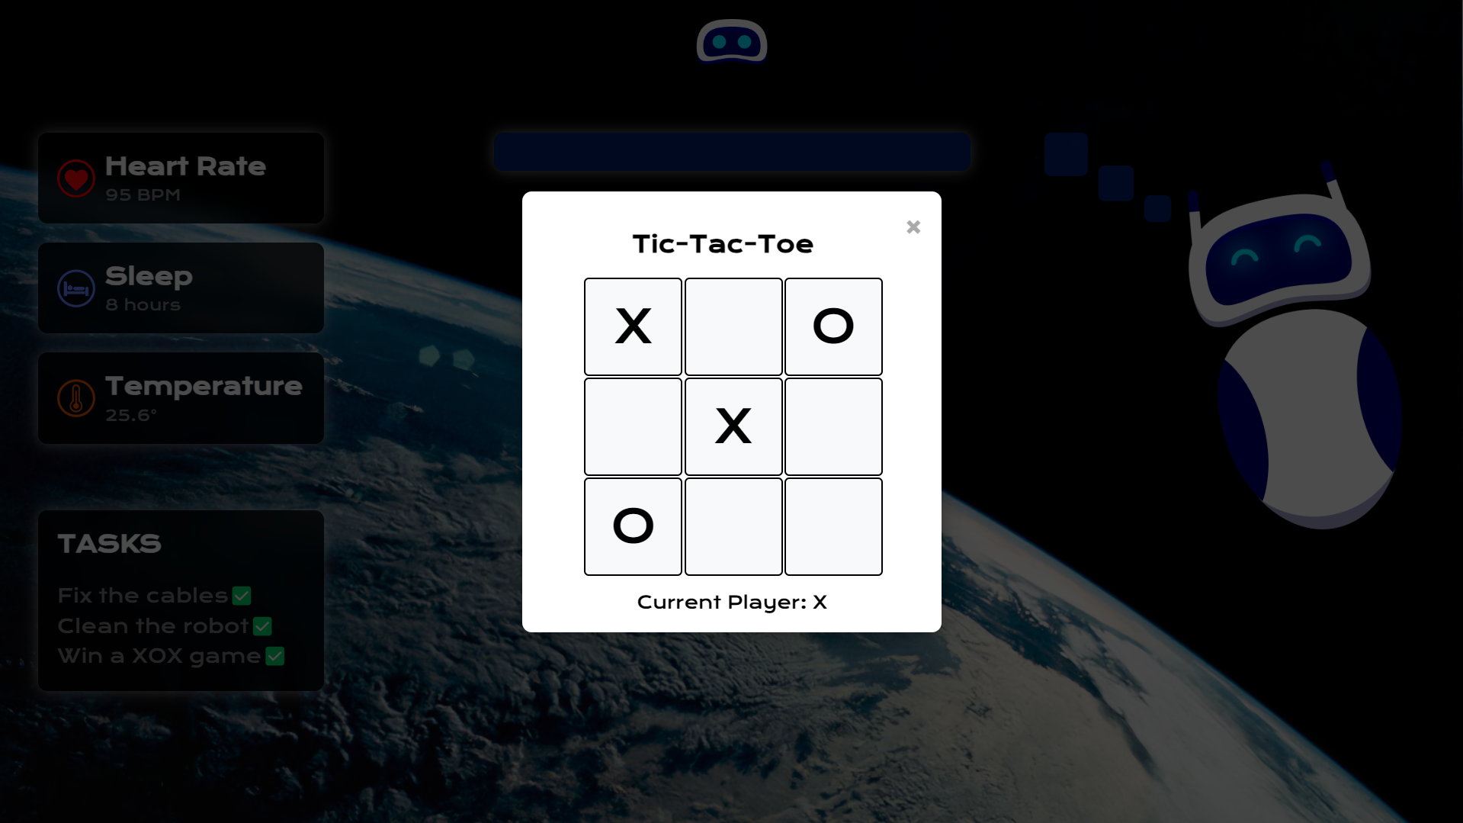
But why?
Reminds
tasks
Provides emotional balance
Supports physical health

Slide 7

Orbitmate.earth
By Öncü Astronomi
Gökdeniz Yıldız
Okan Baysal
Yasin Emir Koç
26
Galactic Games: Fun in a Microgravity Environment

